Slide 1
UNIT IV -Part 2
IOT Platforms Design
Methodology
Mrs. Kiran M. Pradhan
Internet of Things
MSc.CS FY Sem-II
07-04-2020

Slide 2
IOT Platforms Design Methodology
It includes:
Purpose & Requirements Specification
Process Specification
Domain Model Specification
Information Model Specification
Service Specification

Slide 3
IOT Platforms Design Methodology
IoT Level Specifications
Functional view Specification
Operational View Specification
Device & component Integration
Application Development

Slide 4
Process Specification
Purpose : A home automation system that allows controlling of the lights in a home remotely using a web application.
Behavior : The home automation system should have auto and manual
modes. In auto mode, the system measures the light level in the room and
switches on the light when it gets dark. In manual mode, the system provides the option of manually and remotely switching on/off the light.
System Management Requirement : The system should provide remote monitoring and control functions.
Data Analysis Requirement : The system should perform local analysis of the data.
Application Deployment Requirement : The application should be deployed locally on the device, but should be accessible remotely
Security Requirement : The system should have basic user authentication capability.

Slide 5
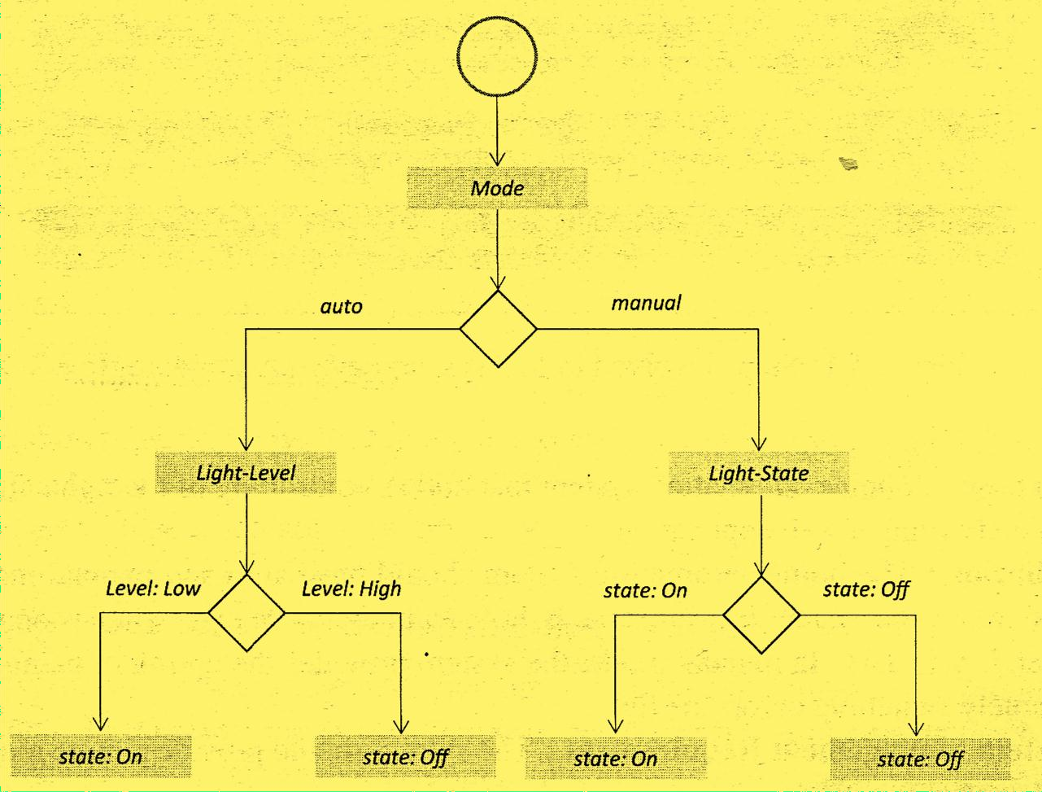
Process Specification(second step)
In this step, the use cases of the IoT system are formally described based on and derived from the purpose and requirement specifications.

Slide 6
Domain Model Specification
The third step in the IoT design methodology is to define the Domain Model.
The domain model describes the main concepts, entities and objects in the domain of IoT system to be designed. Domain model defines the attributes of the objects and relationships between objects.
Domain model provides an abstract representation of the concepts, objects and entities in the IoT domain, independent of any specific technology or platform.

Slide 7
Domain Model Specification
The entities, objects and concepts defined in the domain model include:
Physical Entity : Physical Entity is a discrete and identifiable entity in the physical environment (e.g. a room, a light, an appliance, a car, etc.).
Virtual Entity : Virtual Entity is a representation of the Physical Entity in the digital world.
Device :provides a medium for interactions between Physical Entities and Virtual Entities. Devices are either attached to Physical Entities or placed near Physical Entities.

Slide 8
Domain Model Specification
Resource : Resources are software components which can be either "on-device" or "network-resources". On-device resources are hosted on the device and include software components that either provide information on or enable actuation upon the Physical Entity to which the device is attached.
Service : Services provide an interface for interacting with the Physical Entity. Services access the resources hosted on the device or the network resources to obtain information about the Physical Entity or perform actuation upon the Physical Entity.

Slide 9
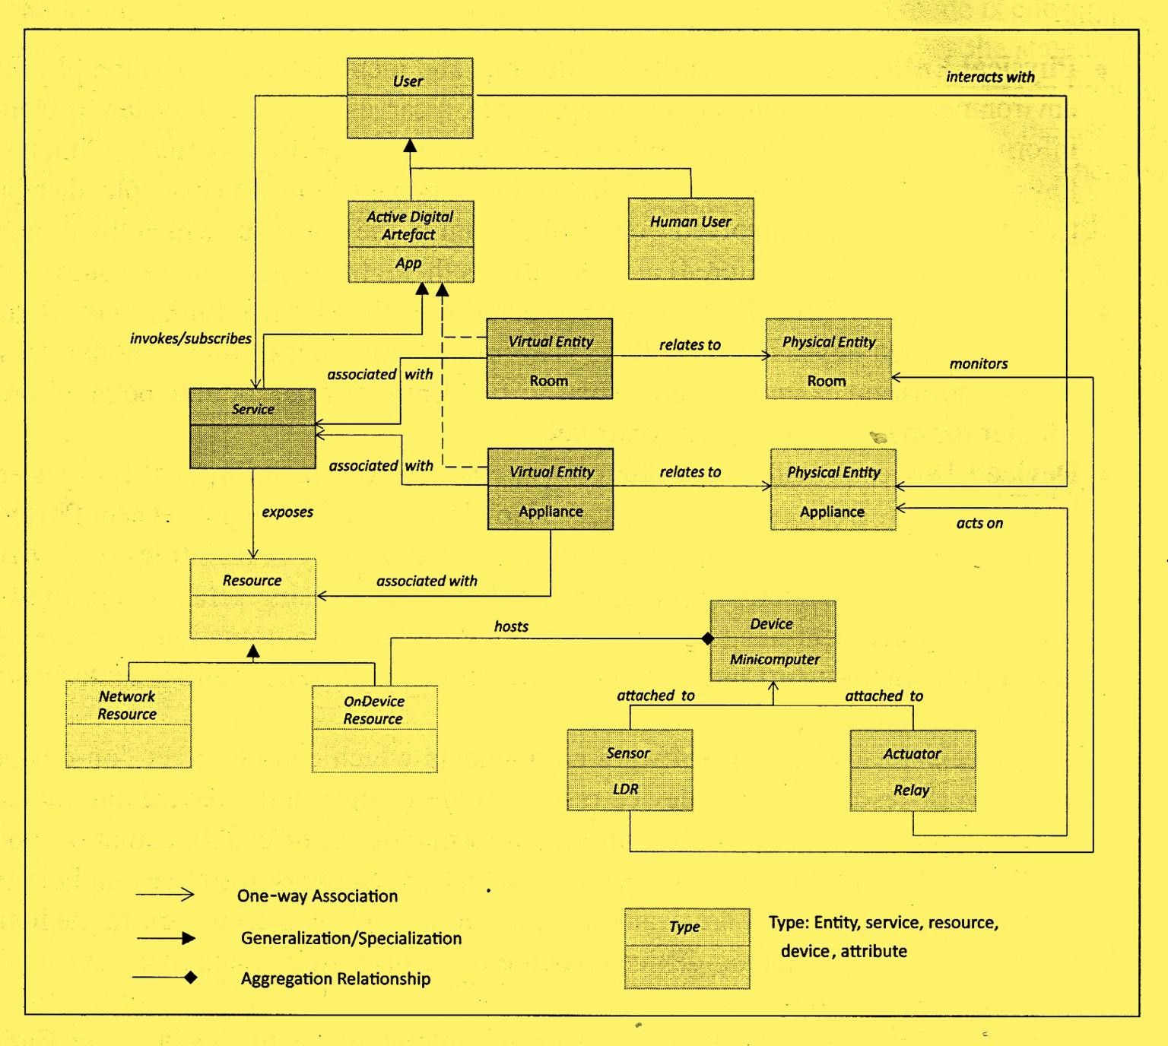
Domain Model Specification

Slide 10
Thank you
Ref: IOT by Ashdeep Bahga &Vijay Madisetti
51

