Slide 1
Application of Enzymes in Industry By Manisha A. Dhotre

Slide 2
Why use enzyme for industrial process?:
1 . Lactase is used in a chlorine-free denim bleaching process which also enables a new fashion look.
2. Fructosyltransferase is used in the food industry for the production of functional sweeteners.
3. Hydrolases are by far the most widely used class of enzymes in industry.
4. Alpha-acetolactate decarboxylase is used to shorten the maturation period after the fermentation process of beer.
5. In starch sweetening, glucose isomerase is used to convert glucose to fructose, which increases the sweetness of syrup.

Slide 3
Enzyme application in non food material:
Enzyme application in non food material
Leather industry.
Paper industry.
Animal feed industry.
Enzyme application in food material:
Enzyme application in food material
Starch processing industry.
Baking industry.
Dairy industry.
Animal and vegetable food.
Juice and wine industry.

Slide 4
In food industry
In food processing, the enzymes used include amylases from fungi and plants.
These enzymes are used in the production of sugars from starch, such as in making high-fructose corn syrup.
In baking, they catalyze the breakdown of starch in the flour to sugar.
Yeast fermentation of sugar produces the carbon dioxide that raises the dough.
Proteases are used by biscuit manufacturers to lower the protein level of flour.
Trypsin is used to predigest baby foods.
For the processing of fruit juices , cellulases and pectinases are used to clarify fruit juices.
Papain is used to tenderize meat for cooking.

Slide 5
In dairy industry:
In the dairy industry, rennin , derived from the stomachs of young ruminant animals (like calves and lambs) is used to manufacture of cheese, used to hydrolyze protein.
Lipases are implemented during the production of Roquefort cheese to enhance the ripening of the blue-mold cheese.
Lactases are used to break down lactose to glucose and galactose .
In Brewing Industry
In the brewing industry, enzymes from barley are released during the mashing stage of beer production.
They degrade starch and proteins to produce simple sugar, amino acids, and peptides that are used by yeast for fermentation.
Industrially-produced barley enzymes are widely used in the brewing process to substitute for the natural enzymes found in barley.
Amylase, glucanases , and proteases are used to split polysaccharides and proteins in the malt.

Slide 6
Betaglucanases and arabinoxylanases are used to improve the wort and beer filtration characteristics.
Amyloglucosidase and pullulanases are used for low-calorie beer and adjustment of fermentability .
Proteases are used to remove cloudiness produced during storage of beers.
In Starch industry:
In the starch industry , amylases, amyloglucosideases , and glucoamylases convert starch into glucose and various syrups.
Glucose isomerase converts glucose into fructose in production of high-fructose syrups from starchy materials.
In paper industry:
In the paper industry, amylases, xylanases , cellulases , and ligninases are used to degrade starch to lower viscosity, aiding sizing and coating paper.
In biofuel industry:
In the biofuel industry, cellulases used to break down cellulose into sugars that can be fermented (see cellulosic ethanol).

Slide 7
Enzyme for detergent and personal care :
Enzyme for detergent and personal care Laundry detergent and automatic dishwashing detergents.
Enzyme application in detergent began in the early 1930 with the use of pancreatic enzyme in presoak solution.
In 1931 German scientist otto roham.
In textile:
In the production of biological detergents, proteases , produced in an extracellular form from bacteria, are used in pre-soak conditions and direct liquid applications, helping with the removal of protein stains from clothes.
In molecular biology:
In molecular biology, restriction enzymes, DNA ligase , and polymerases are used to manipulate DNA in genetic engineering, important in pharmacology, agriculture and medicine, and are essential for restriction digestion and the polymerase chain reaction.
Molecular biology is also important in forensic science.

Slide 8
Industrial Uses
Starch conversions
Production of glucose syrup
Production of high fructose corn syrup
Production of high maltose conversion syrups
Production of cyclodextrins
Production of ethanol
Lignocellulosic Biomass conversions
Cellulose conversion
Hemicellulose conversion
Lignin conversion

Slide 9
Industrial Uses
Enzymes in the Production of Functional Oligosaccharides and Other Neutraceuticals
Enzymes in the Modification of Fats and Oils
Enzymes in the Animal Feed Industry
Enzymes in the Pulp and Paper Industry
Enzymes in the Fruit Juice Processing Industry
Enzymes in the Meat and Fish Processing Industry
Enzymes in the Dairy Industry
Enzymes in Detergents
Enzymes in the Leather Industry
Enzymes in the Production of Bulk and Fine Chemicals
Analytical Applications of Enzymes
Enzyme-Replacement Therapy

Slide 10
Starch conversions
Starch contains about 15–30% amylose and 70–85% amylopectin.
Enzymes have largely replaced the use of strong acid and high temperature to break down starchy materials.
Three types of enzymes are involved in starch bioconversion:
endo-amylase (a-amylase, EC 3.2.1.1), [Bacillus lichiniformis, Bacillus subtilis, and Bacillus amyloliquefaciens and fungi such as Aspergillus oryzae]
exo-amylases
glucoamylase or glucan 1,4-a-glucosidase, EC 3.2.1.3 [Endomycopsis, Aspergillus, Penicillium, Rhizopus, and Mucor];
b-amylase, EC 3.2.1.2) [Bacillus megaterium, Bacillus cereus, Bacillus polymyxa, Thermoanaerobacter thermosulfurogenes, and Pseudomonas sp.]
debranching enzymes (pullulanase, EC 3.2.1.41; isoamylase, EC 3.2.1.68). [Aerobacter aerogenes and isoamylase is produced by Pseudomonas amyloderamosa.]

Slide 11
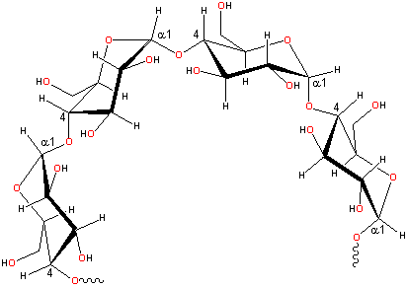
In amylose these are linked α -(1, 4)-, with the ring oxygen atoms all on the same side.

Slide 12
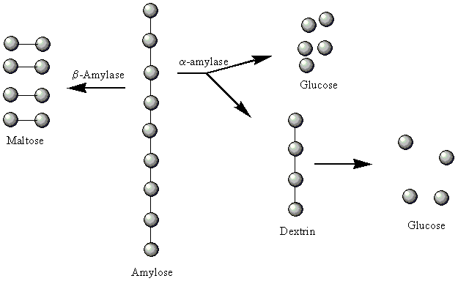
α -1,4
hydrolyzes the α-1,4-glycosidic bonds in starch from the nonreducing ends, generating maltose. The enzyme is unable to bypass the α-1,6 linkages and leaves dextrins, known as β-limit dextrins
Hydrolyse internal (endo) a- 1,4 but not a- 1,6 producing malto-oligosaccharides
Enzymatic hydrolysis of amylose

Slide 13
Enzymes for starch conversion
a-amylase randomly hydrolyse a-1,4 linkages in both amylose and amylopectin to yeild mixture of glucose, maltose, maltotriose and series of a-limit dextrins.
b-amylase sometimes used in place of a-amylase. They hydrolyze alternate a-1,4 linkages and yield maltose residues and b-limit dextrins
Glucoamylase hydrolyses a-1,3. a-1,4 and a-1,6 linkages but is less efficient than a-amylase. Major role is to break cross links of amylopectin resulting in complete breakdown to glucose. Generally used to reduce CHO content of beers. Industrially obtained from fungus Aspergillus niger.
Glucose isomerase is used for conversion of glucose obtained after processing to fructose.
Pullulanase (pullulan α-1,6-glucanohydrolase) or isoamy- lase (glycogen α-1,6-glucanohydrolase) cleaves the α-1,6- linked branch points of starch and produces linear amylosaccharides of varying lengths.

Slide 14
There are 3 major plant-derived protease E used commercially today : -Papain is derived from papaya plant. -Bromelain from the pineapple plant. -Ficin from the fig papain& bromelain which are commonly used as meat tenderizers. *Ficin being more limited in use due to its more dangerous proteolytic activity. -Barley amylase is also used to make maltose syrup.

Slide 15
Meat Tenderizing Enzymes The two most often used meat tenderizing enzymes are Papain and Bromelain. Both are derived from plant sources. These are the papaya fruit and the pineapple plant
Other sources of enzymes have been cited for meat tenderization such as B.subtilis; A.oryzae & pancreatin

Slide 16
FOOD STUFF INDUSTRY
Alkaline phosphatase and invertase present in milk are inactivated within same temperature range as it is required for pasteurization. So the activities of enzyme at the end of process give indication of its effectiveness
Degree of bacterial contamination: Enzyme assay
Example: Reductase : methylene blue to colourless leuco methylene blue under anaerobic condition
Degree of sprouting: stored wheat seeds------kept at moist condition or prolonged rain at harvest time----- increase in production of alpha amylase------- breakdown of starch and proteins------- flour produced is not suitable for baking
Freshness of meat ---- monoamine oxidase

